Slide 1

Martina Reverberi - Nicholas Braglia
Web System Development – Final Project

Slide 2
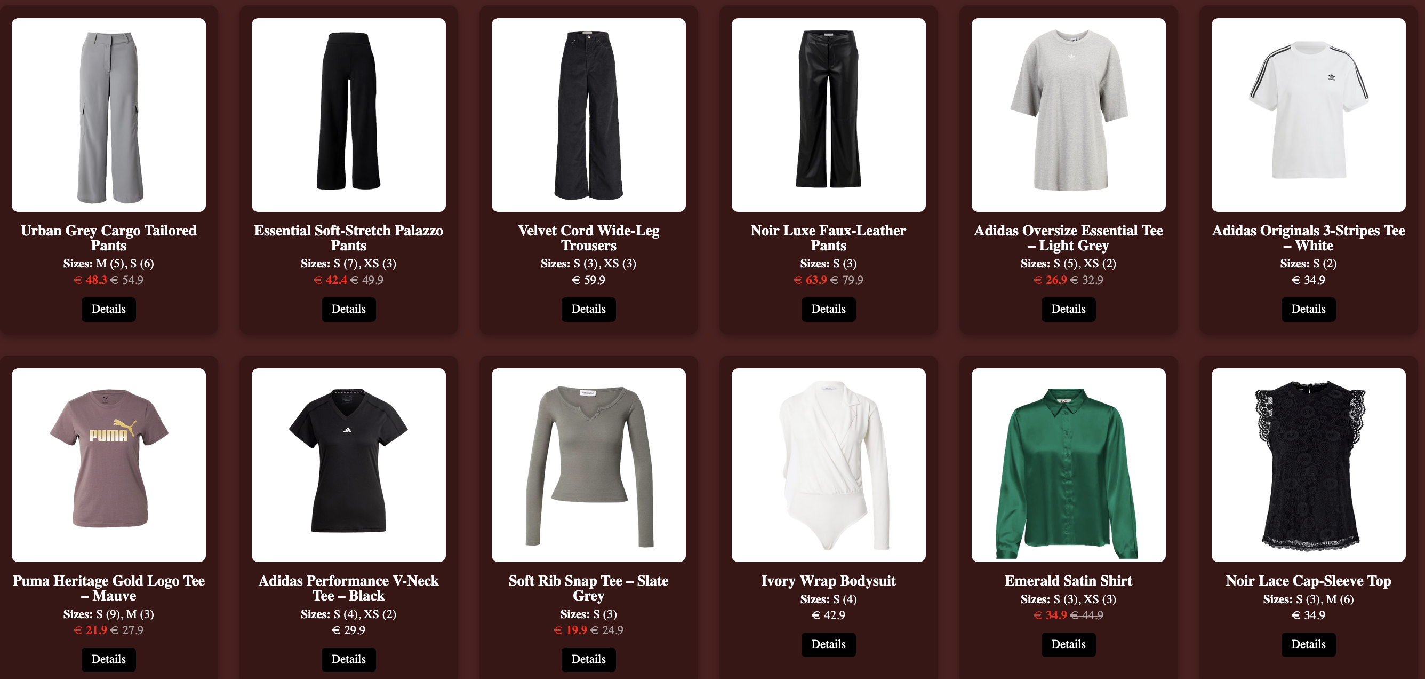
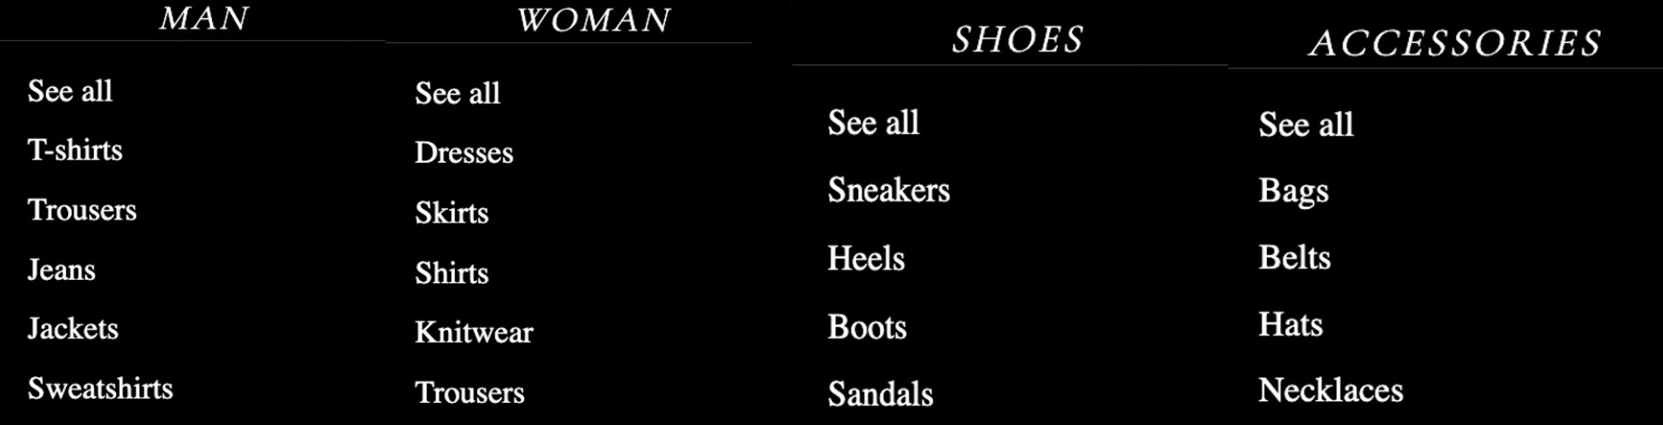

Slide 3

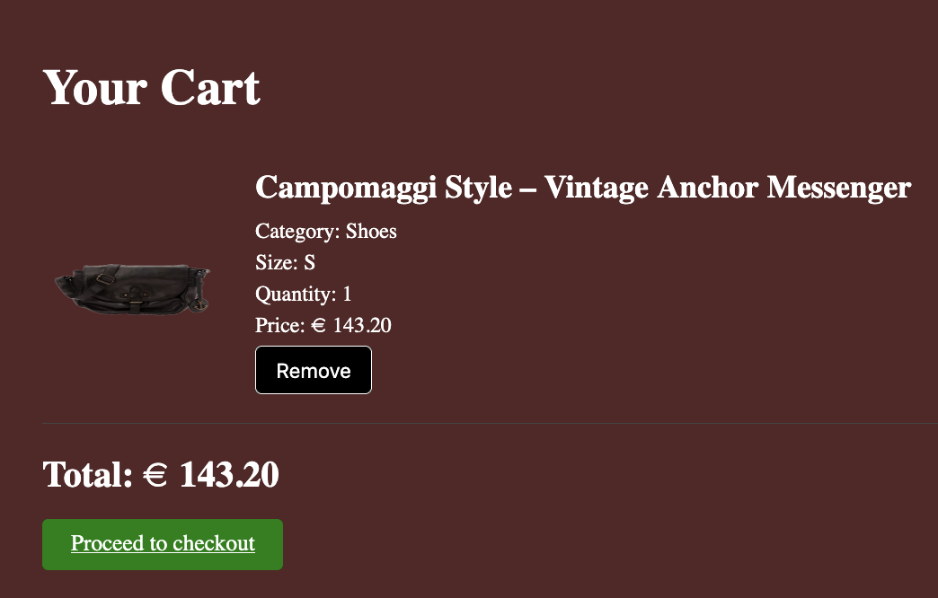
(availability number)

Slide 4
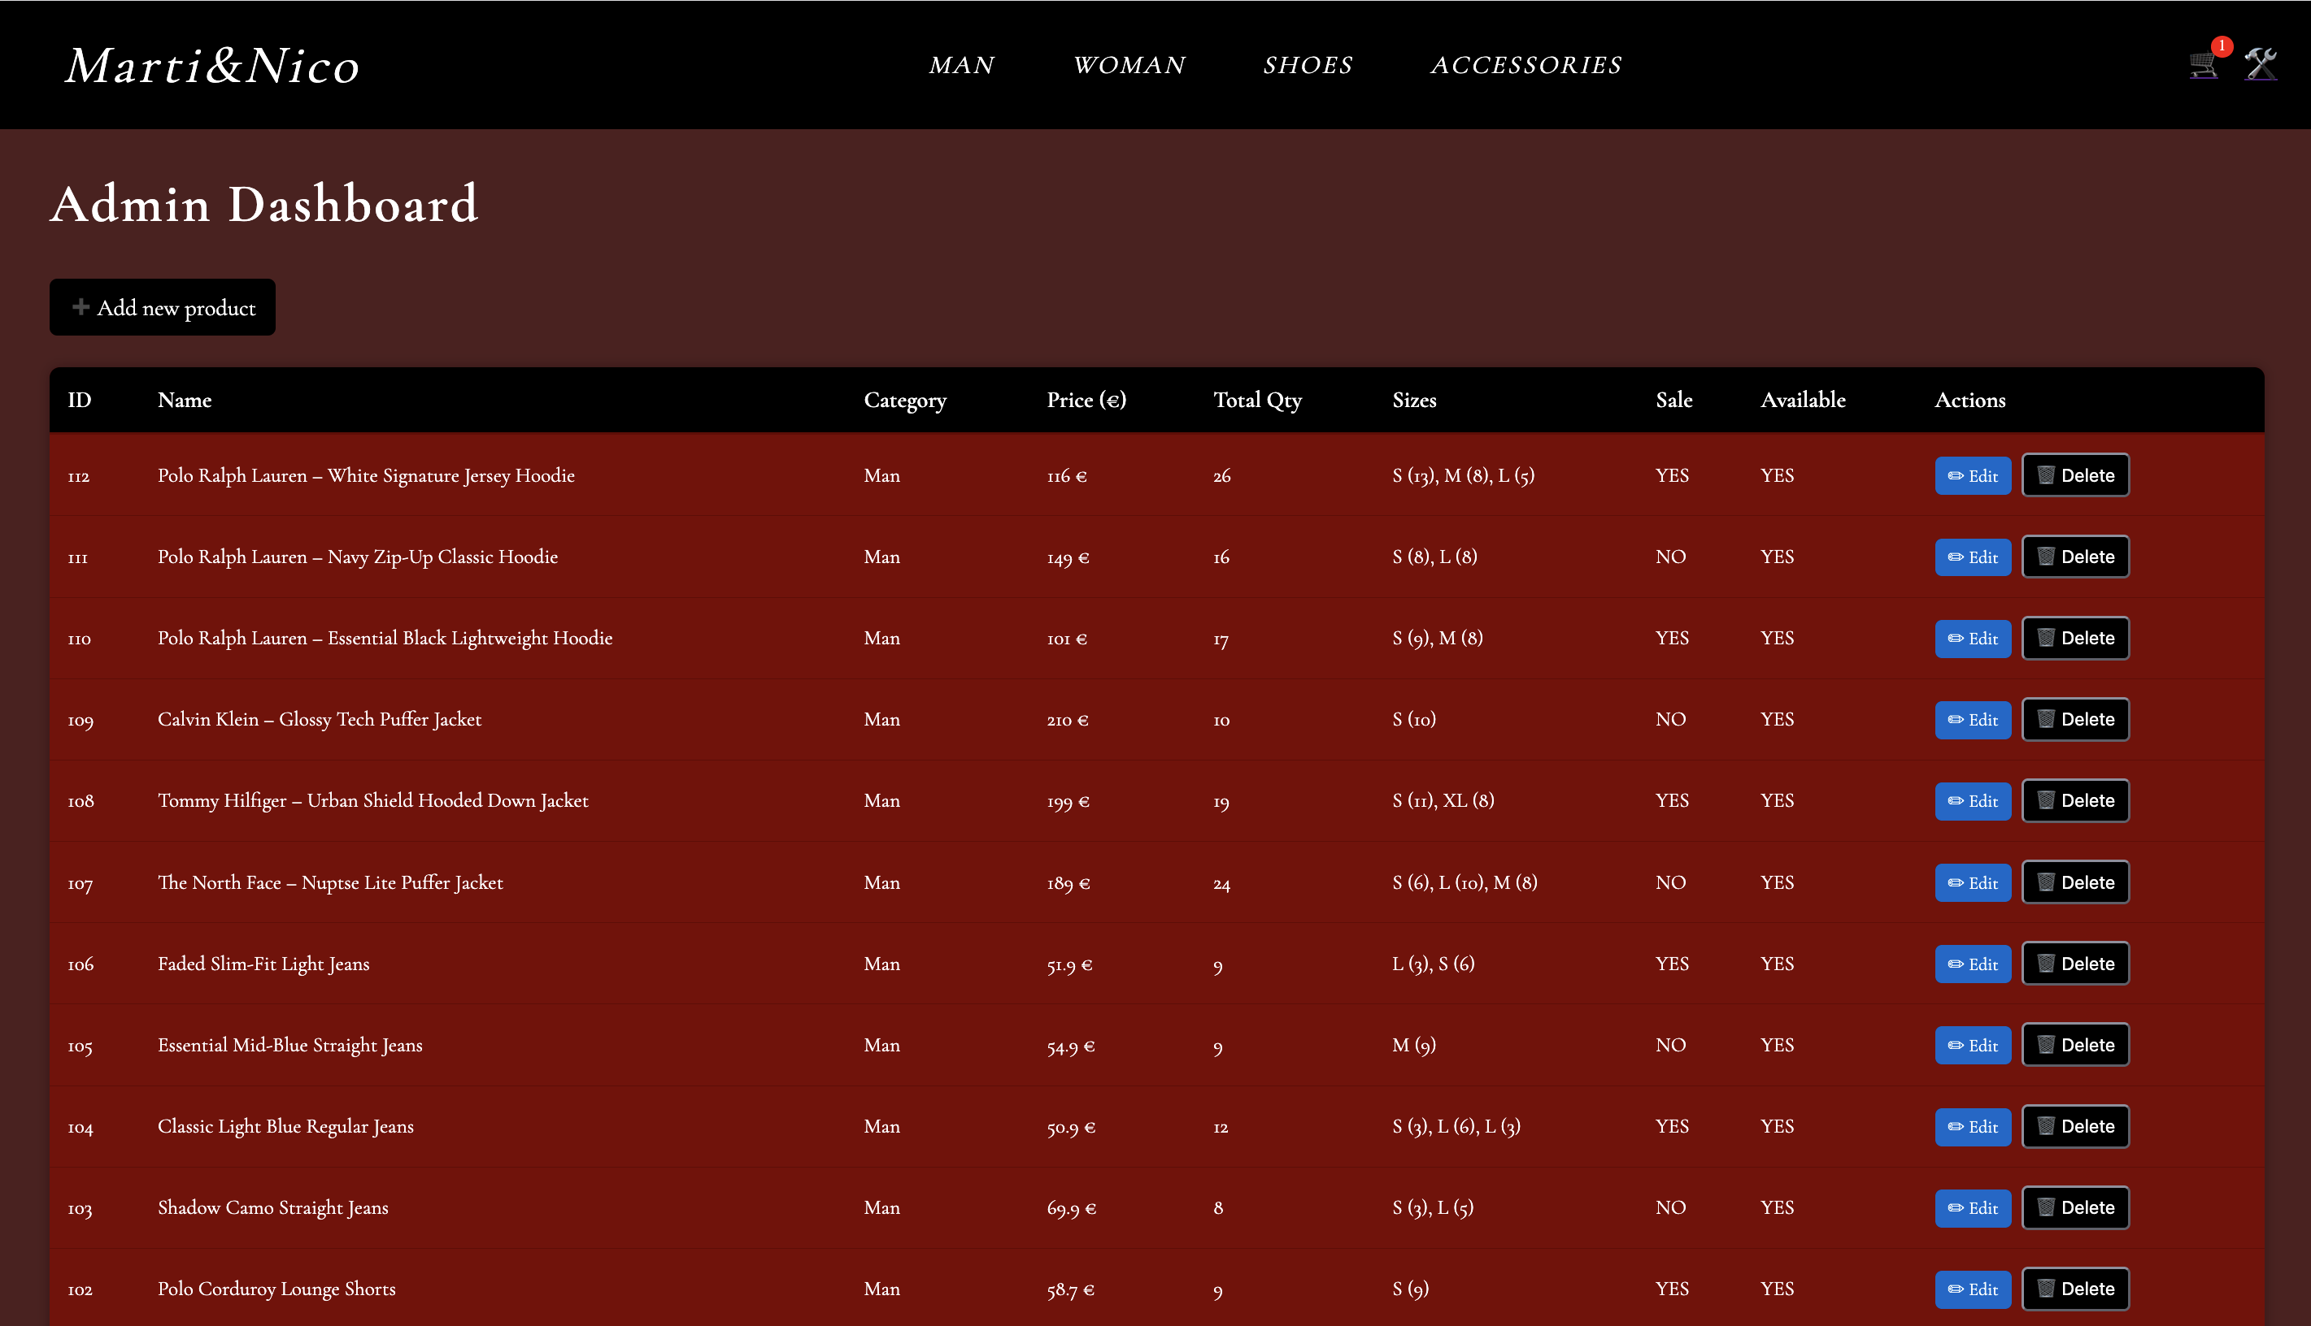
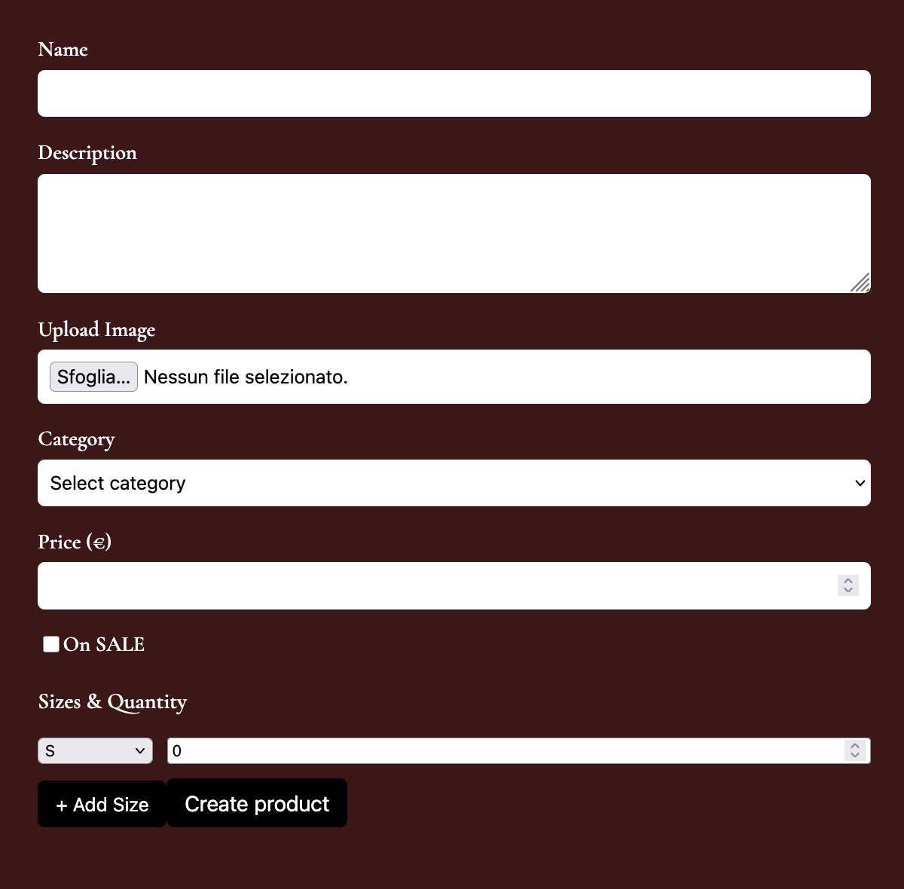

Slide 5
Project Overview
Frontend (React)
Backend REST API (Node + Express)
SQLite database
Image upload (Multer)
Admin dashboard + customer area
Frontend Technologies
React 19 + Vite
React Router
Context API (cart management)
CSS Modules
Fetch API to communicate with backend
Backend: Technologies
Node.js
Express
SQLite
Multer (file upload)
Zod (input validation)
Database Tables
categories
subcategories
products
product_sizes

Slide 6

Thank you for your attention

